Slide 1
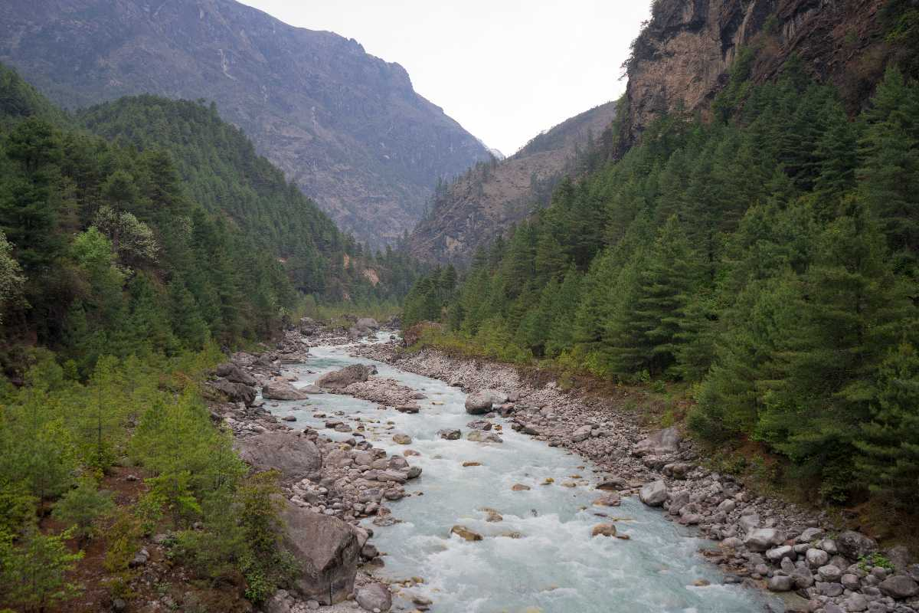
IMPROVING SOLAR PANEL
EFFICIENCY
Chelsey Vambute Josh Pollack
Mark Brown Andrew Vitale
Jess Nikon

Slide 2
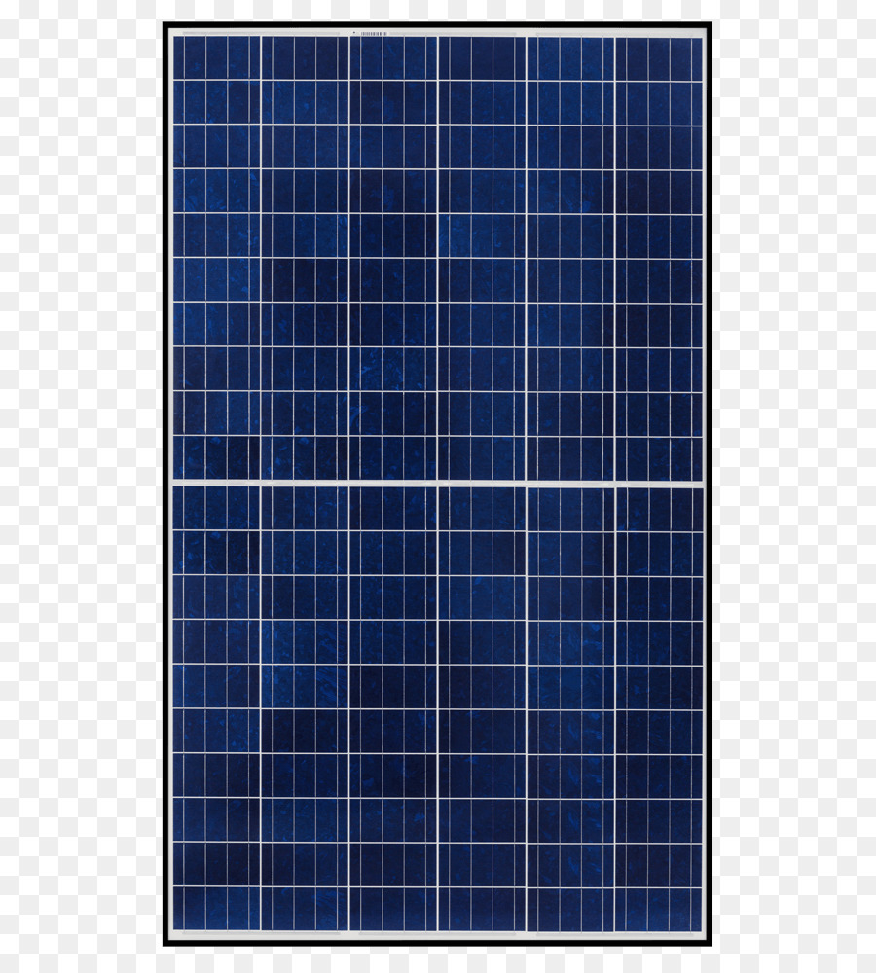
DEFINING THE PROBLEM
A village in Thori, Nepal acquires their energy primarily via solar panels. However the changing position of the sun reduces the amount of power generated, and these solar panels alone are not enough to power the town throughout the entire day.

Slide 3
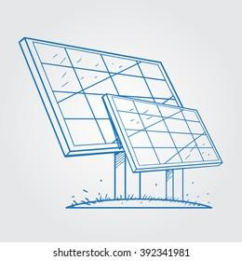
WHY WE CHOSE THIS PROJECT:
Notes:
*this is where i can explain how i assumed this would be simple as it should only be 180 degrees and how i was wrong but the mistake carries through to the preliminary designs.

Slide 4
WHAT WE DID

Slide 5
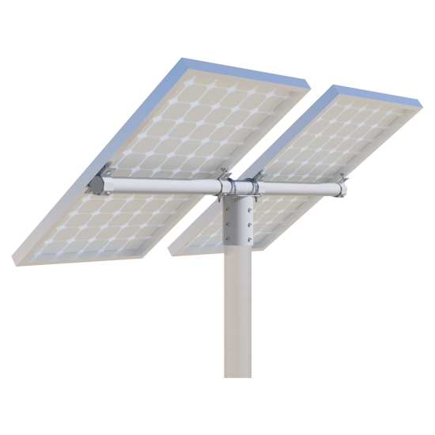
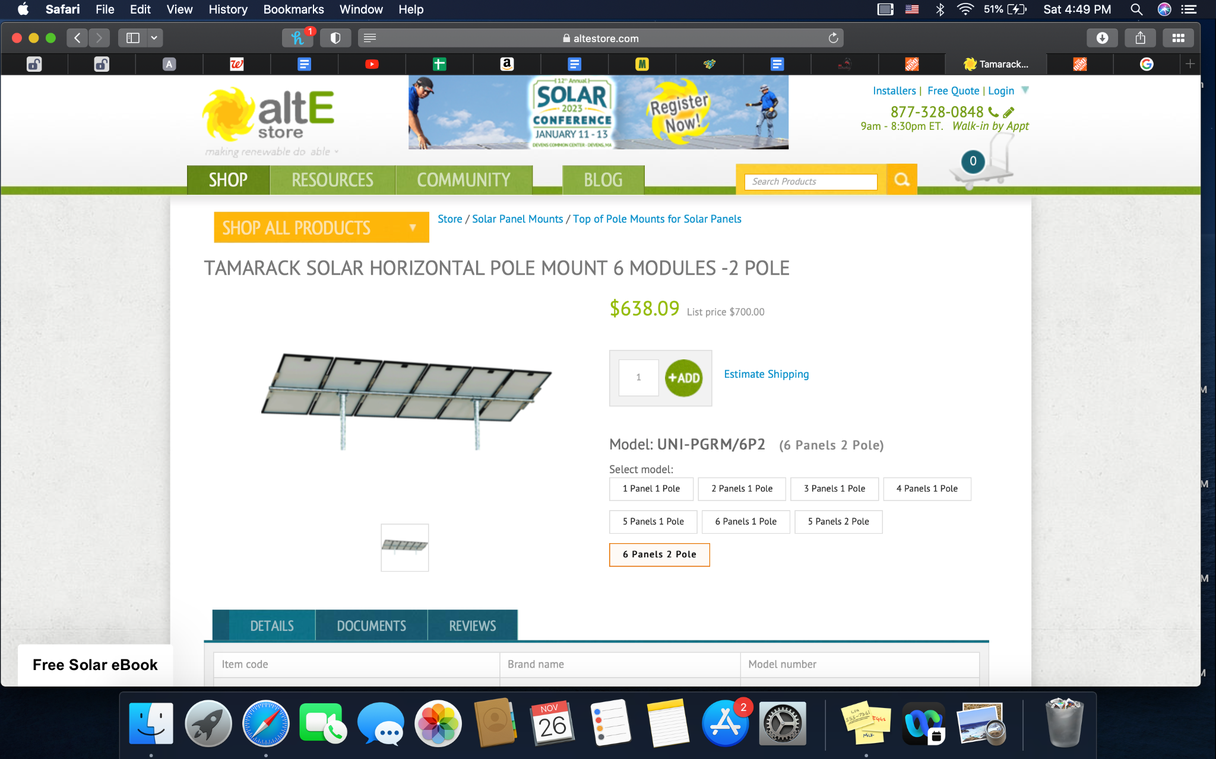
Tamarack Solar Horizontal Pole Mount:

Slide 6
Preliminary Design #1
Pros
Cons
The first design introduced the movement that we wanted to achieve
- Improved energy production
- Material heavy and therefore not cost effective
- No solar tracking

Slide 7
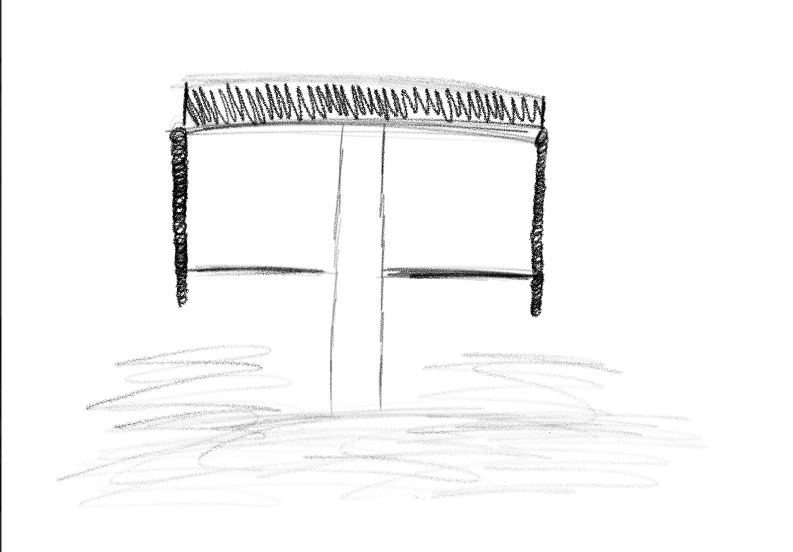

Slide 8
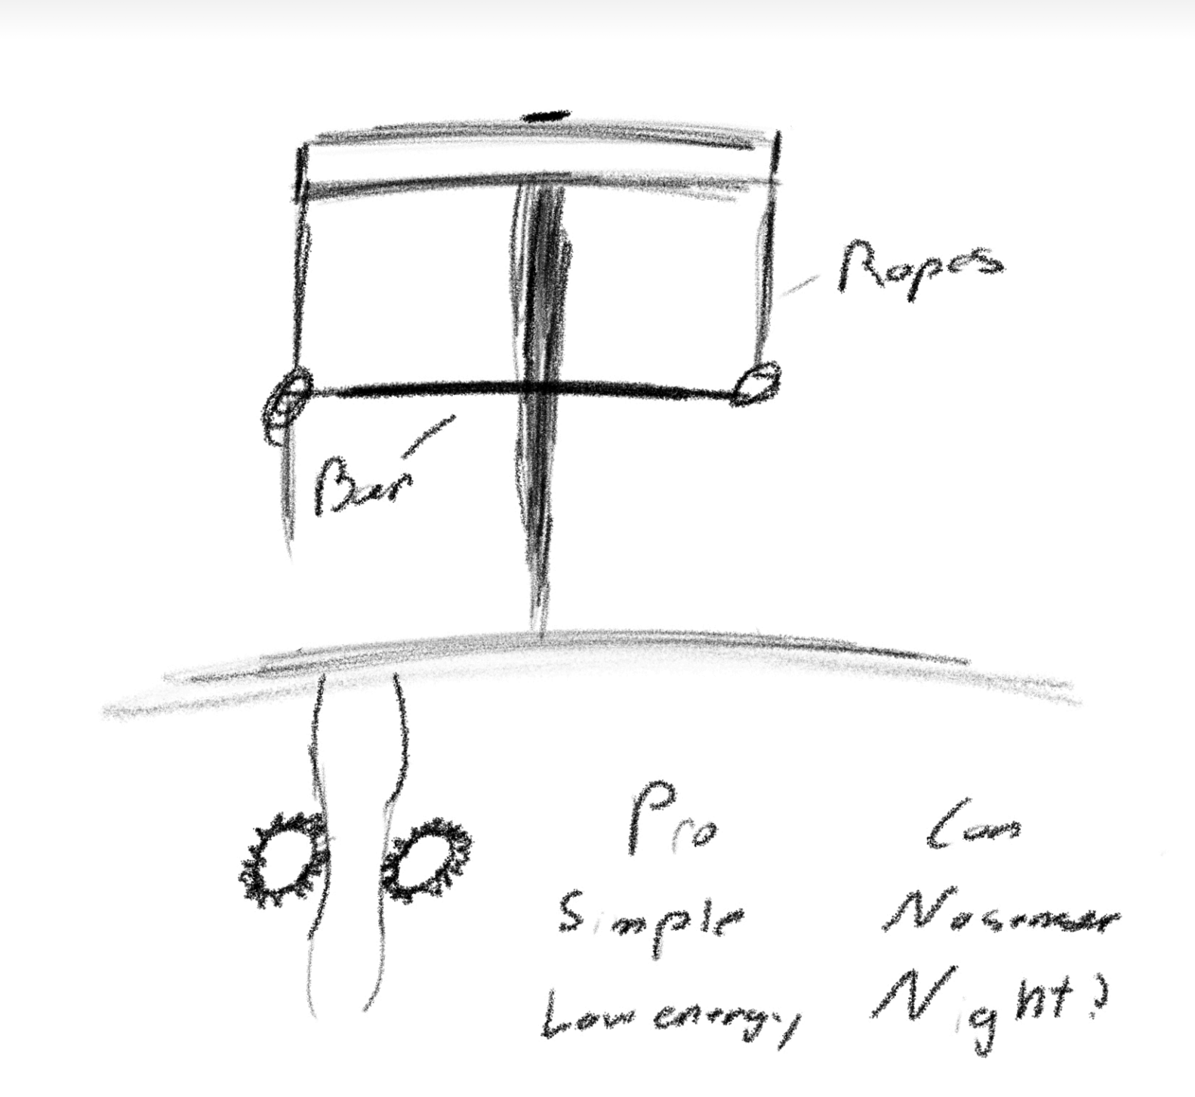

Slide 9
Estimated Bill of Materials:
For Tamarack Horizontal Pole Mount 6 panels- 2 poles
Initial build:
40BB17H-½” Sprocket wheel for #40 roller chain (x4/ panel, 24 total) = $357.60
#40 roller chain ½” pitch (200ft/panel, 1200 ft total) = $795
Aluminum housing w/ angle iron (1x96in/ $14, 8 total) = $122
TowSmart 1in bearing kit ($15.26/ panel) = $91.56
Base mounted motor = $473
Motor mounting base plate = $29.52
Replacement parts:
Ventura KMC 112 link bicycle chain = $10.24
Aluminum angle iron 96in = $14
TowSmart 1in bearing kit /2 = $15.26
*sprocket wheels and gears are made for harsher conditions. Extras included in estimate. Interchangeable, so replacements should not be needed*
**Assuming solar panels and pole mount are provided**
Approximate cost:
$1868.68/ 6 panels

Slide 10
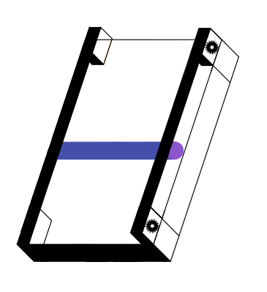
Preliminary Design #2
Goals:
Cons:
The second design introduced the idea of distributing weight on the surface of the panel in order to change its position.
- Clean off the dirt on the panel and increases efficiency
- Shifting the rollers position would tip the panel to the correct angle
- Blocks a portion of the panel at all points
- U rings around support pole have too wide of a range of motion
- Roller could damage the panel

Slide 11
Estimated Bill of Materials:
For Tamarack Horizontal Pole Mount 6 panels- 2 poles
Initial build:
40BB17H-½” Sprocket wheel for #40 roller chain (x4/ panel, 24 total) = $357.60
#40 roller chain ½” pitch (200ft/panel, 1200 ft total) = $795
Additional connecting gears approximately $60/panel = $360
PVA squeegee = $94.95
Aluminum housing w/ angle iron (1x96in/ $14, 8 total) = $122
TowSmart 1in bearing kit ($15.26/ panel) = $91.56
Replacement parts:
PVA replacement roller =$ 35.65
Ventura KMC 112 link bicycle chain = $10.24
Aluminum angle iron 96in = $14
TowSmart 1in bearing kit /2 = $15.26
*sprocket wheels and gears are made for harsher conditions. Extras included in estimate. Interchangeable, so replacements should not be needed*
**Assuming solar panels and pole mount are provided**
Approximate cost:
$1821.11/ 6 panels

Slide 12
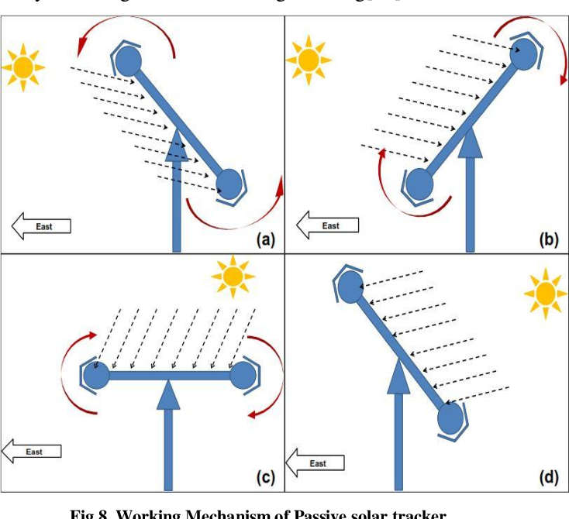
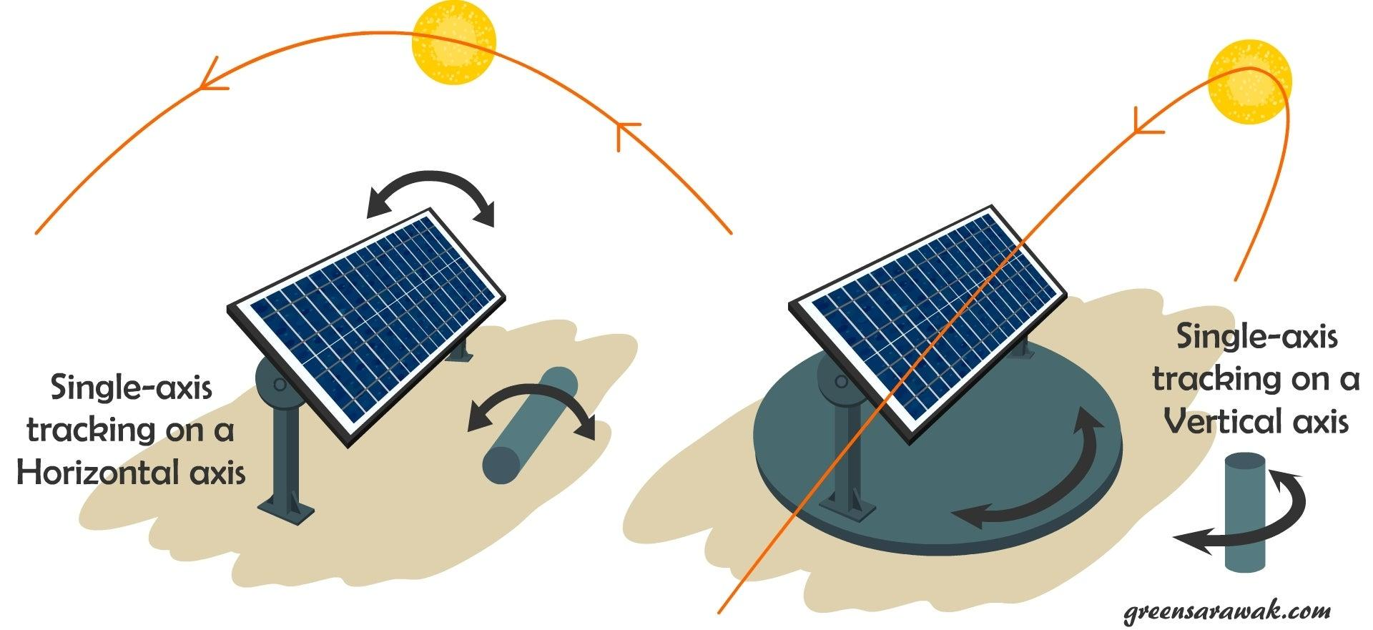
Designs Used in US
Solar Trackers
Passive Trackers
They track the sun with a sensor and move to follow the sun. They use 1-4% of the panels energy, but increase efficiency by over 40%. They require lots of upkeep and maintenance on lots of small moving parts.
Passive Trackers use a low boiling point gas. It is driven to one side or the other when it is heated up by the sun. This will cause the panel to tilt and aim towards the sun better to create a 90 degree angle. It takes a long time to tilt though, up to an hour.
Source
Source

Slide 13
Preliminary Design #3
Pros:
Cons:
The forth design uses a take on a magnifying glass in focusing the light through a cone in a glass ball to a senor panel to tracker the sun
Finds a way to track the sun’s movements throughout the day but focusing the light to a senor
The cone is refined to a point not allowing enough variance in the output of light(incorrect tracking)
Large(not singular panel precise)

Slide 14
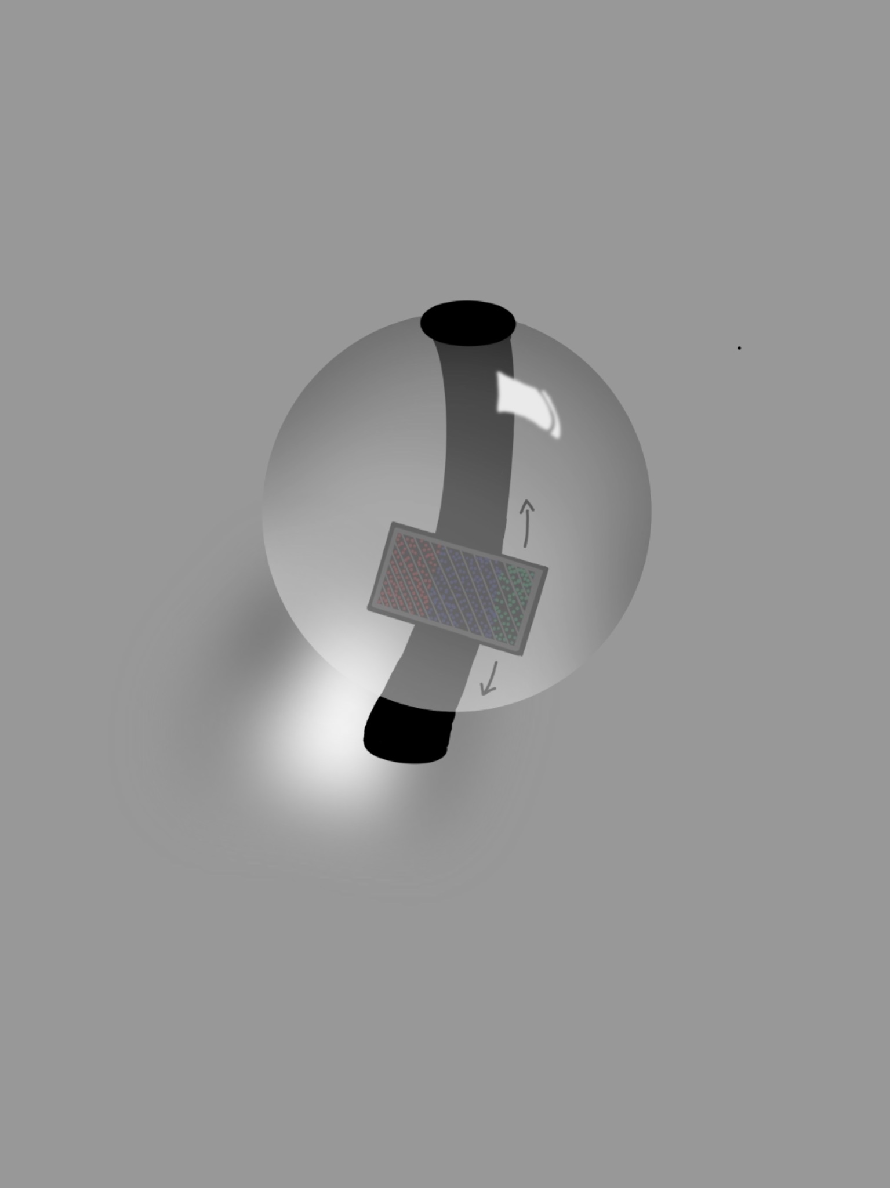

Slide 15
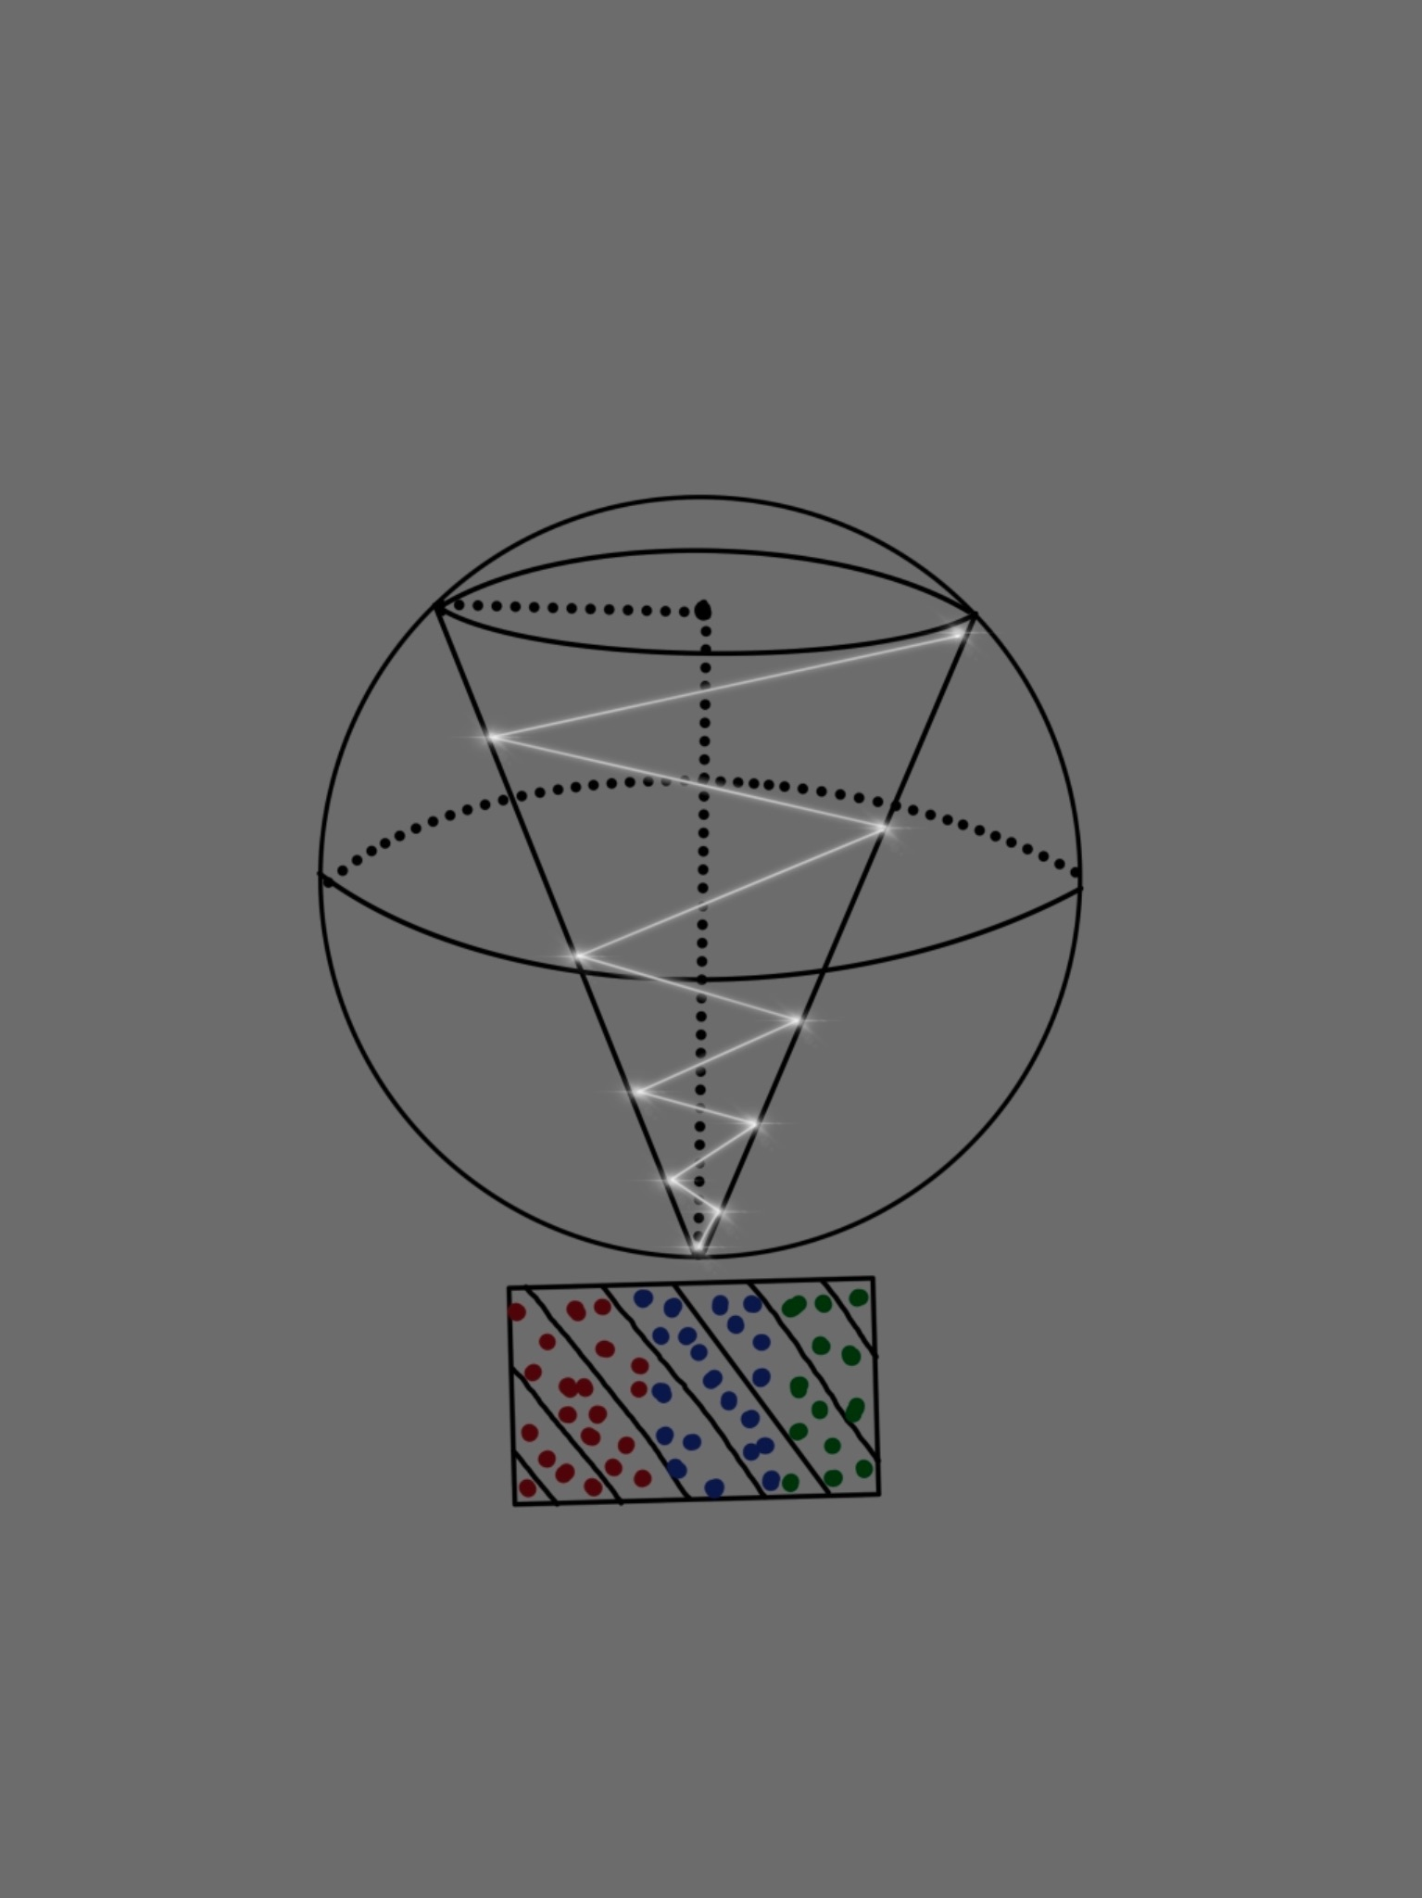
Notes:
https://www.youtube.com/watch?v=Kp6IwV_ks70

Slide 16
Estimated Bill of Materials:
For Tamarack Horizontal Pole Mount 6 panels- 2 poles
Initial build:
- Mylar film (40 sq ft) = $20.79
- Corrugated plastic (4320 sq in) = $24.97
- Broadcom limited light sensor = $30.54
- ABS dome (1 semicircle) = $12
- Aluminum support w/ angle iron (1x96in) = $14
Connected to the system:
Signals will be read and interpreted by a chip a raspberry pi = $118-175
**Assuming solar panels and pole mount are provided**
Approximate cost:
$102.30/ solar tracker

Slide 17
THORI, NEPAL
Weather:
Solar:
Population:
Thori is a providence in a rural municipality of the Parsa district in Nepal. It was formed in 2016 and got power in 2020.
Avg temp:
High: 30.4 C
Low: 19.4 C
Avg rain:
107.75 mm
UV index:
6.25
Sunshine hours:
12.2 hrs
20,296 people on 49.68 cubic miles
https://www.weather-atlas.com/en/nepal/bhikhna-thori-climate

Slide 18


RUNNING THE NUMBERS:
 | Thori, Nepal
Energy use per person/yr | 19.09 GJ
Rich Solar: Mega 200 Watt 24 Volt Solar Panel

Slide 19
ESTIMATES:
Energy use: 248 GJ/ 19 GJ= 13.05 | Ratio: 1 person in US: 13 people in Thori
1 mount w/ 6 panels= 4 people in US | 1 mount w/ 6 panels= 24 people in Thori
Population- rural town: 200 | 200/24= 8.3, Round to 9
Ratio of interest: 1 person in US: 6 people in Thori | Total: 9 pole mounts & 54 solar panels

Slide 20
Final Design:
Pros:
Cons
A combination of aspects from the previous designs in a scalable system. Designed to not require intervention.
- Capable of providing enough energy now and in the future.
- Scalable
- Durable
- Fairly expensive to implement
- Parts are specific
- Getting all the parts together will require some time

Slide 21
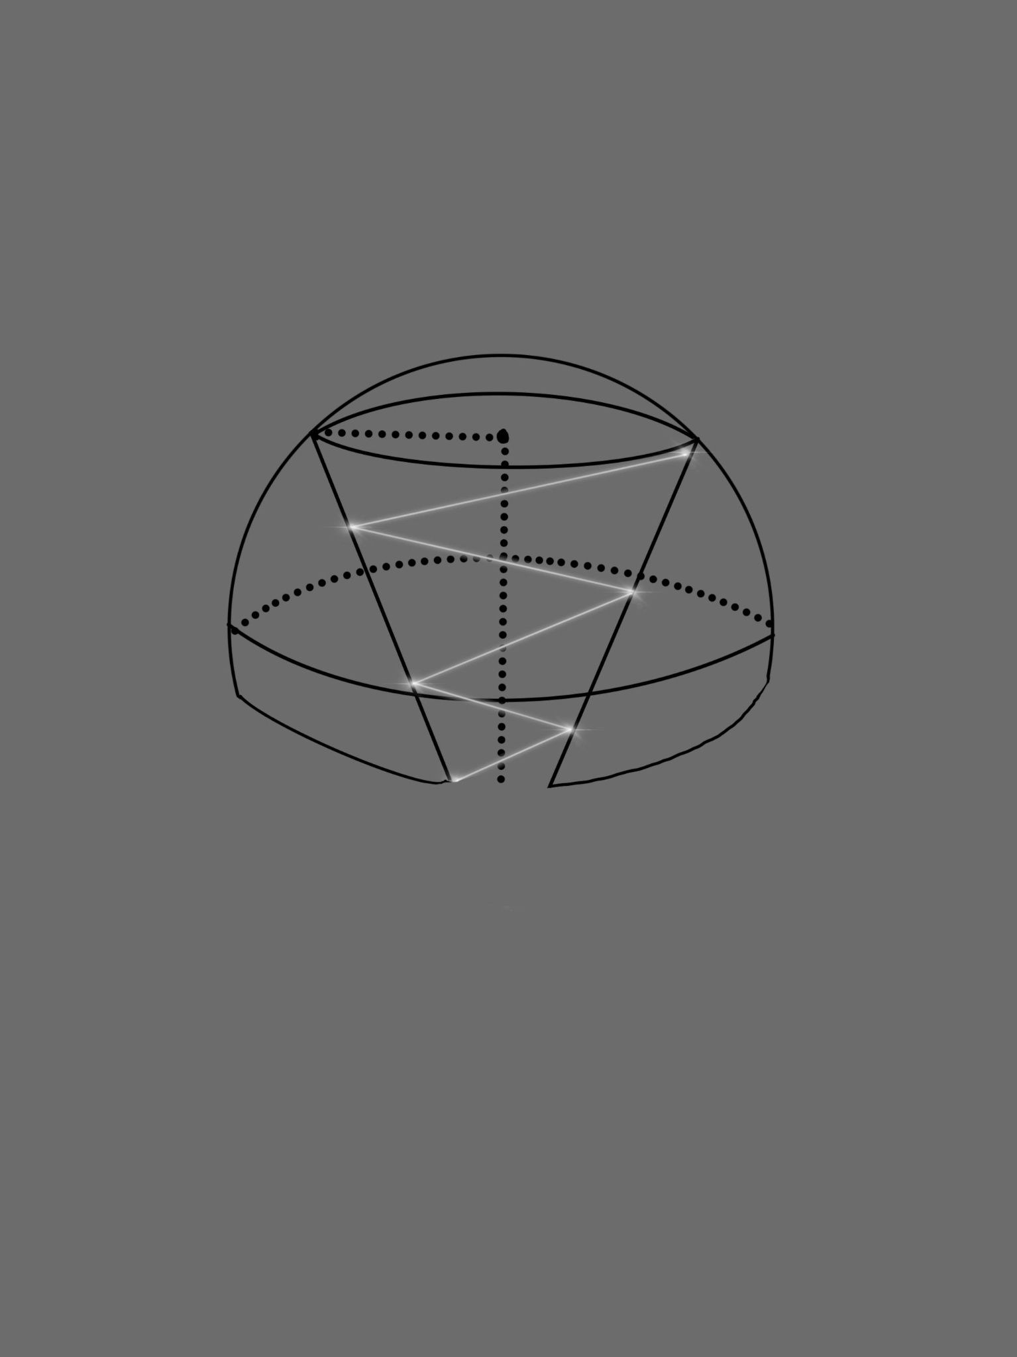
How were turning the panels:
https://www.youtube.com/watch?v=Kp6IwV_ks70

Slide 22
Estimated Bill of Materials:
For Tamarack Horizontal Pole Mount 6 panels- 2 poles
Solar tracker:
Mylar film (40 sq ft) = $20.79
Corrugated plastic (4320 sq in) = $24.97
Broadcom limited light sensor = $30.54
ABS dome (1 semicircle) = $12
Aluminum support w/ angle iron (1x96in) = $14
Panel mounting and movement system:
Gears in mechanism (sprocket wheels, etc) = $ 200
Dust proof timing belt (estimated range) = $34-70
Standard stainless steel unthreaded pipe (estimated range) = $150-300
Mounting hardware (estimated range) = $50
*sprocket wheels and gears are made for harsher conditions. Extras included in estimate.*
**Assuming solar panels and pole mount are provided**

Slide 23
Closing the system:
Solar panels 200 Watts 24 Volts (1) $349.99 Undiscounted $249.99 Discounted
Controller 60 Amps (1) $499.99 Undiscounted $349.99 Discounted
Lithium Iron Phosphate Battery 200 Amp Hours (1) $1,799.00 Undiscounted $999.99 Discounted
3a) 2 Deep Cycle Lead Acid battery (100 Amp Hours) for a more cheaper option Quantity: (1) $399.99 Undiscounted $249.99 Discounted
Pure Sine Wave Converter 1,000 Watts (1) $369.99 Undiscounted $219.99 Discounted
Solar Panel to Controller cables (+ and -) 10 Gauge, 20 feet (1) $44.99
Controller to battery cables (+ and -) 10 Gauge, 10 Feet (1) $29.99

Slide 24
IMPACT:
On the People:
REVENUE LAST YEAR
On the Environment:
2,000
Longevity:
EMPLOYEES
More productive
Sense of reliability
Improve public health
Increased jobs
Ability to diversify
Inc. standard of living
No air pollution produced
Carbon footprint for producing materials is high
Potential pollution to the immediate habitat
Designed to have minimal need for intervention
Ratios allow for population growth and stability
Individual mounts can be removed from the system

